Slide 1

Enhancing Skincare Recommendations for The Glow Company
By Chi Dang

Slide 2
Agenda:
Introduction + Overview of the Client and Their Goal
Understand the Data
Data Cleaning Process
Descriptive Analysis
Visualization Techniques
Predictive Methods
Generalized Linear Model (GLM) Insights
Conclusion and Future Recommendations

Slide 3

Data Introduction + Client’s Overview & Goals
Client: The Glow Company
Question: What demographic and employment factors have the strongest correlation with high income status (over $50K/year)? Identifying key predictors.
Focus/ Goals: What influencing factors that The Glow Company’s consumers have income above $50K
Collaboration Objective: Refining skincare recommendations for a more effective and personalized routine

Slide 4


Understand the Data
Dataset: Adult Income Census from Kaggle
Origin: Extracted from 1994 Census Bureau by Ronny Kohavi and Barry Becker.
Number of Rows: 32,561
Number of Columns: 15
Y variable: Binary outcome indicating income >$50K
X variables: Age, Marital_Status, Race, Sex, Hrs_per_Week, Income, Net_Capital, EducationLevel_clean, Occupation_clean, & WorkingClass_clean.
Tools using in this project: R Studio & SAS

Slide 5
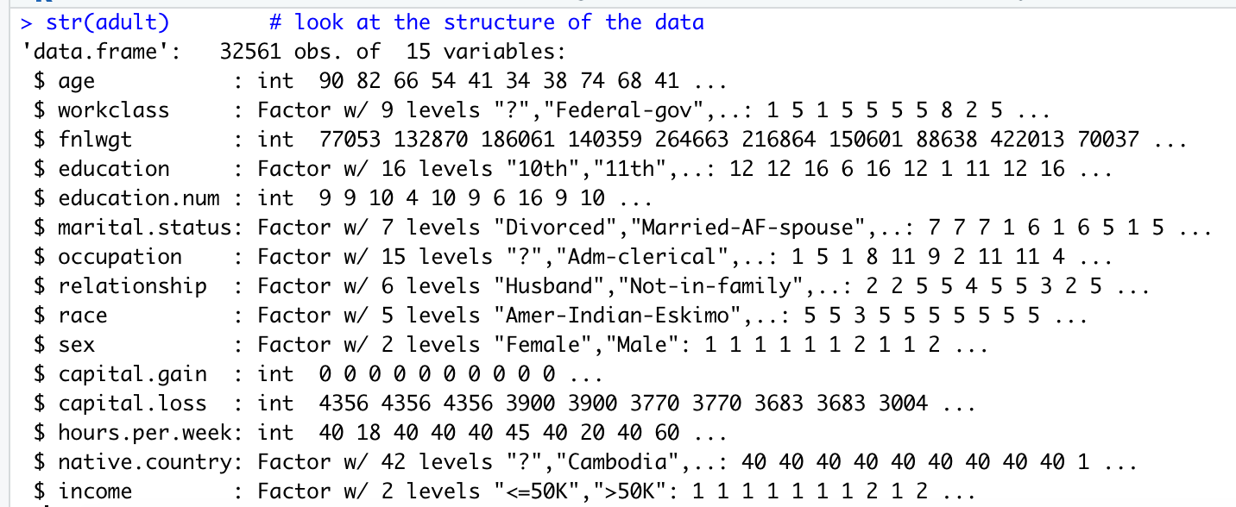
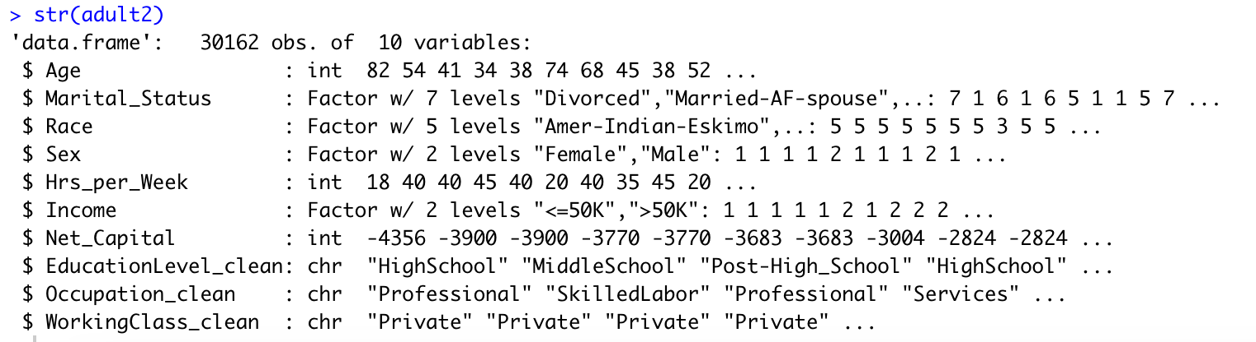
Data Cleaning Process
Before Cleaning:
Handling Special Characters, like '?' in the dataset
Rename columns for a purpose of using it easily in both R & SAS
Adding a new column Net_Capital by subtracting Net_Gain to Net_Loss
Transform the irrelevant variables into one group
Using R Studio to finish the cleaning process and extracting file to computer to upload on SAS
Transform Y variables into binary variable, 0 as <=50K & 1 as >50K
After Cleaning:

Slide 6
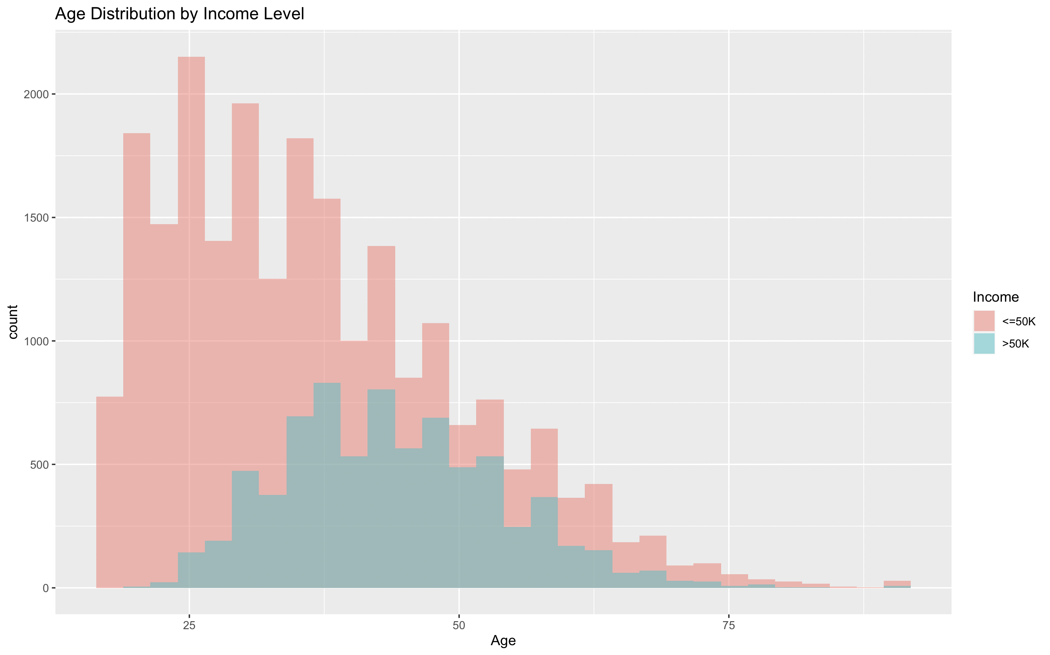
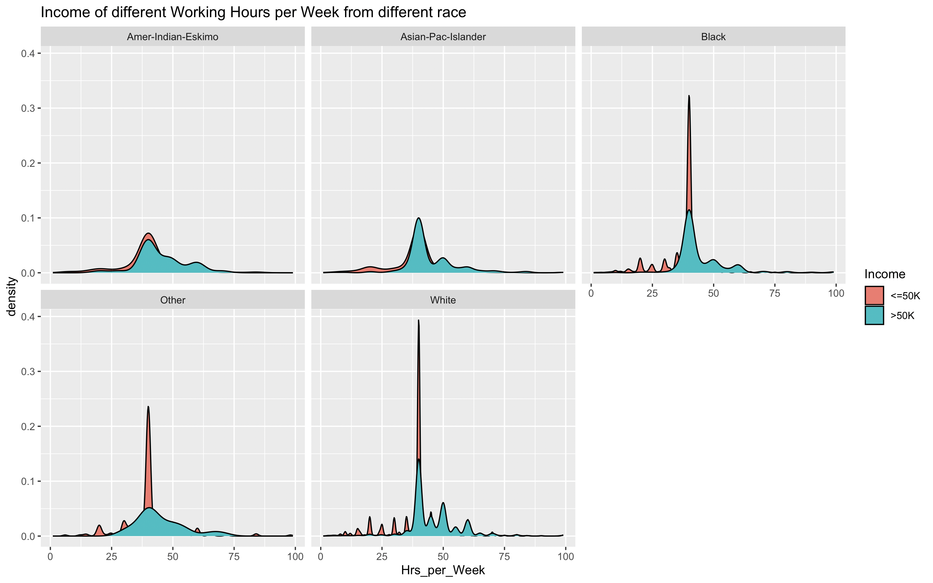
Visualization

Slide 7
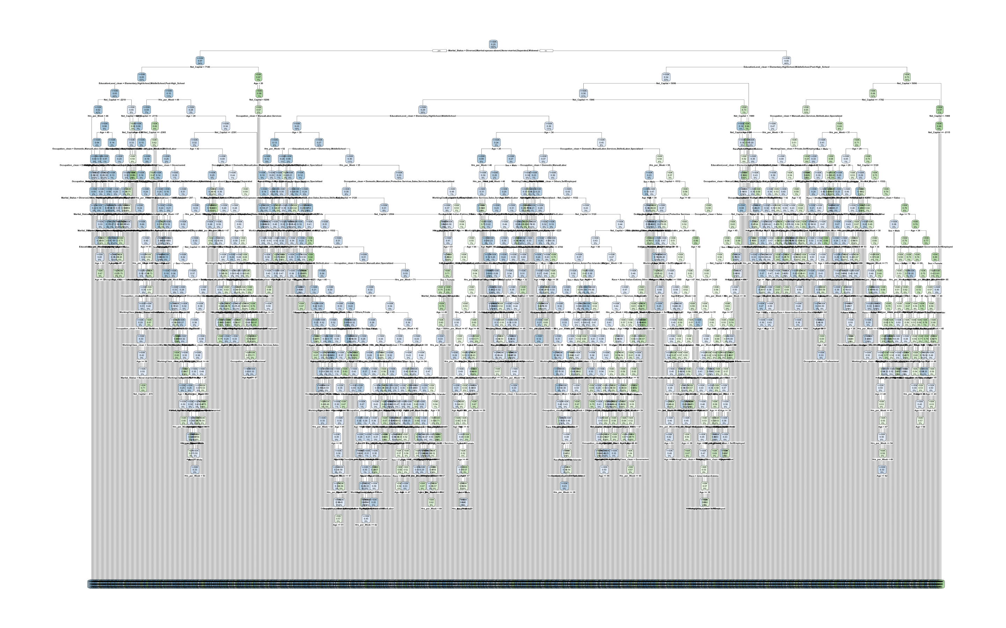
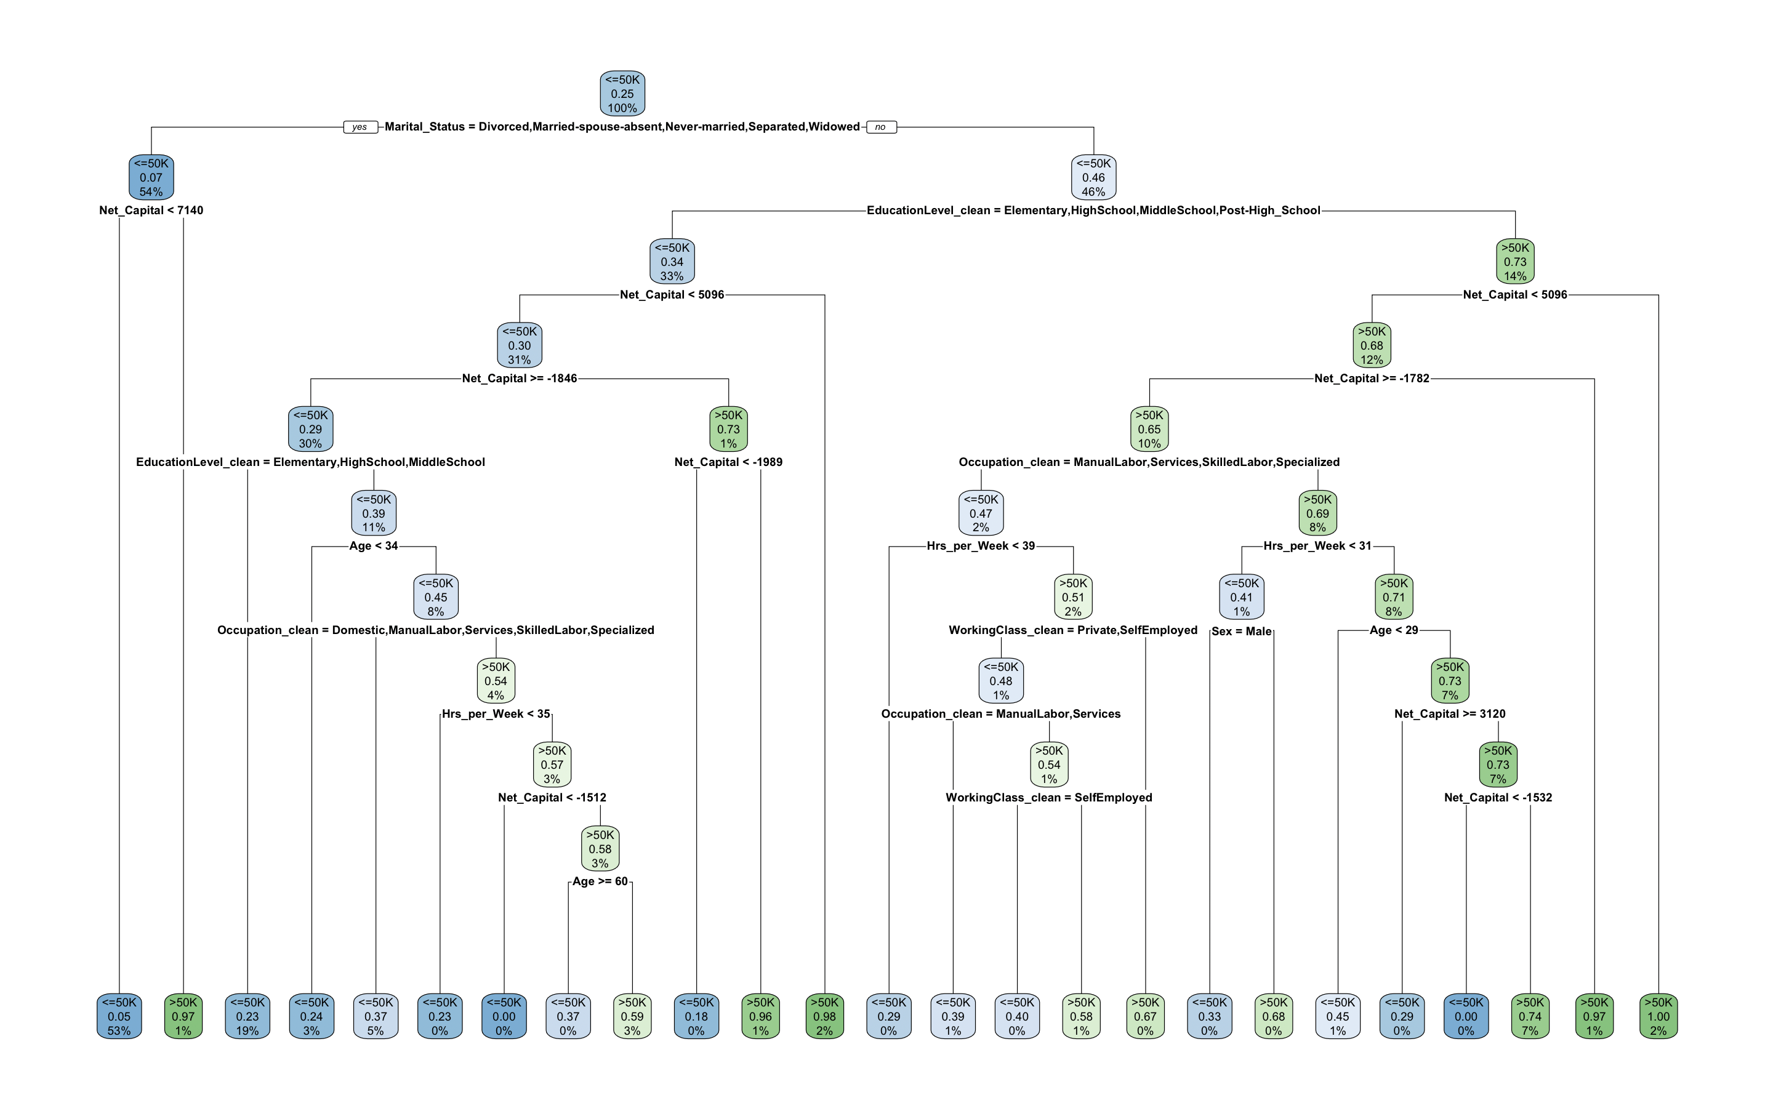
Predictive Methods Pt.1 (Decision Tree)
Before and After Tunning the tree

Slide 8
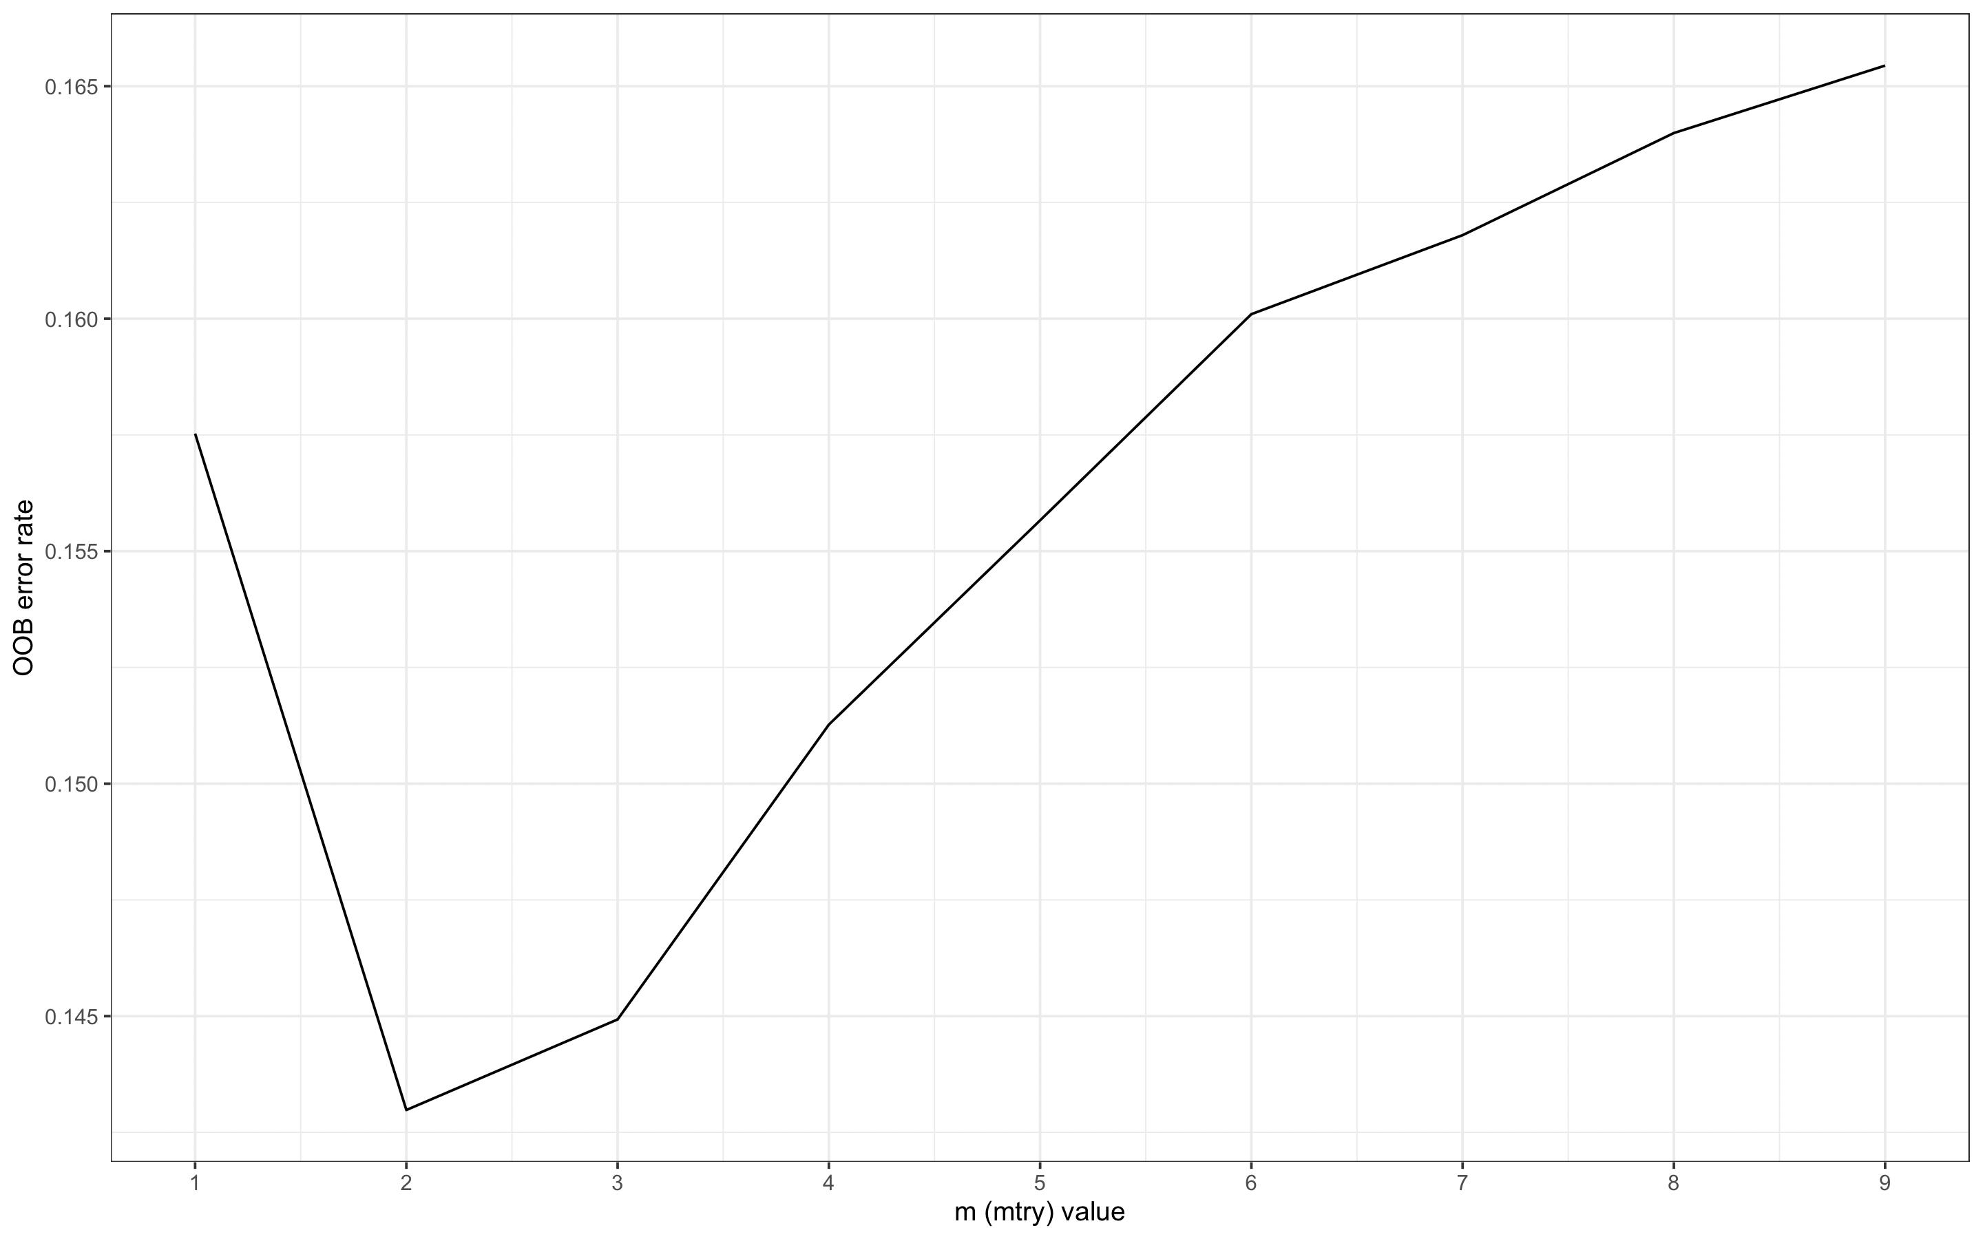
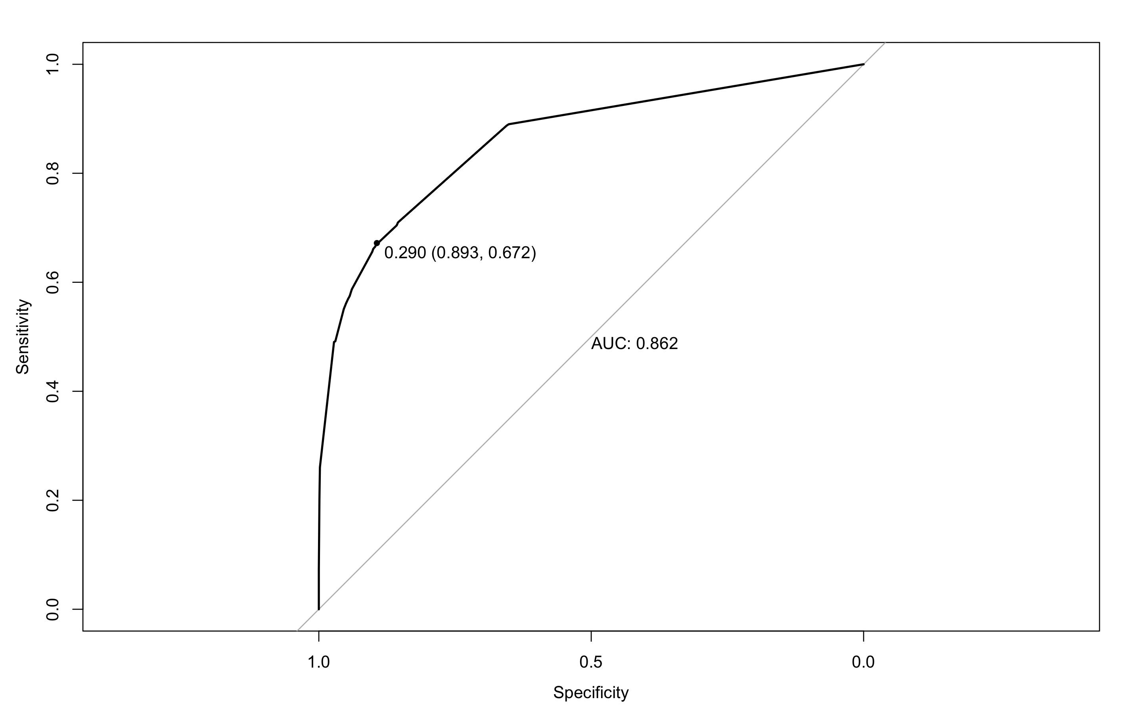
Predictive Method Pt.2 (Random Forest)

Slide 9
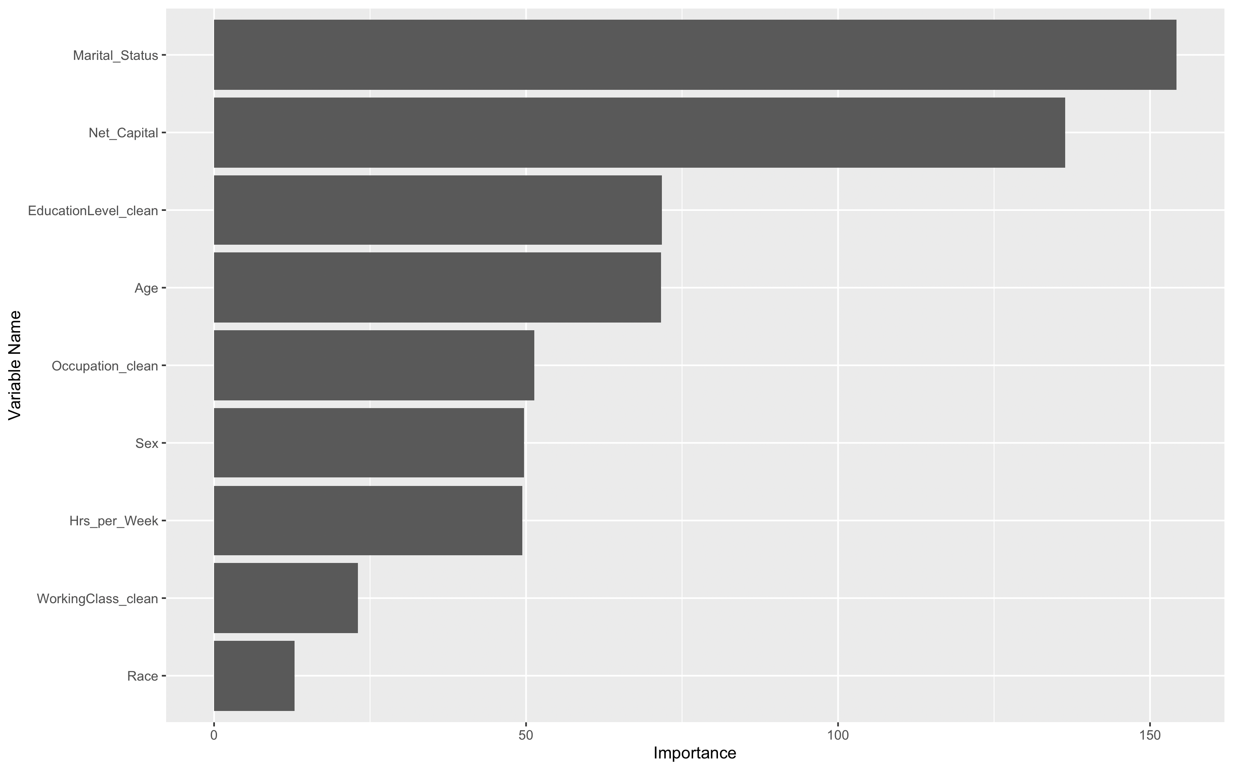
Useful plots for creating GLM
The graph shows us that Martial_Status is the most important variable that affects an individual’s income to be more than >$50K.
However, I took a further step to understand the relationship between income and other variables can affect a person’s earning.
And, all of variables affects a person’s incoming by fitting the model and comparing their AIC/BIC, which the m8 includes all of variables in has the smallest AIC.

Slide 10
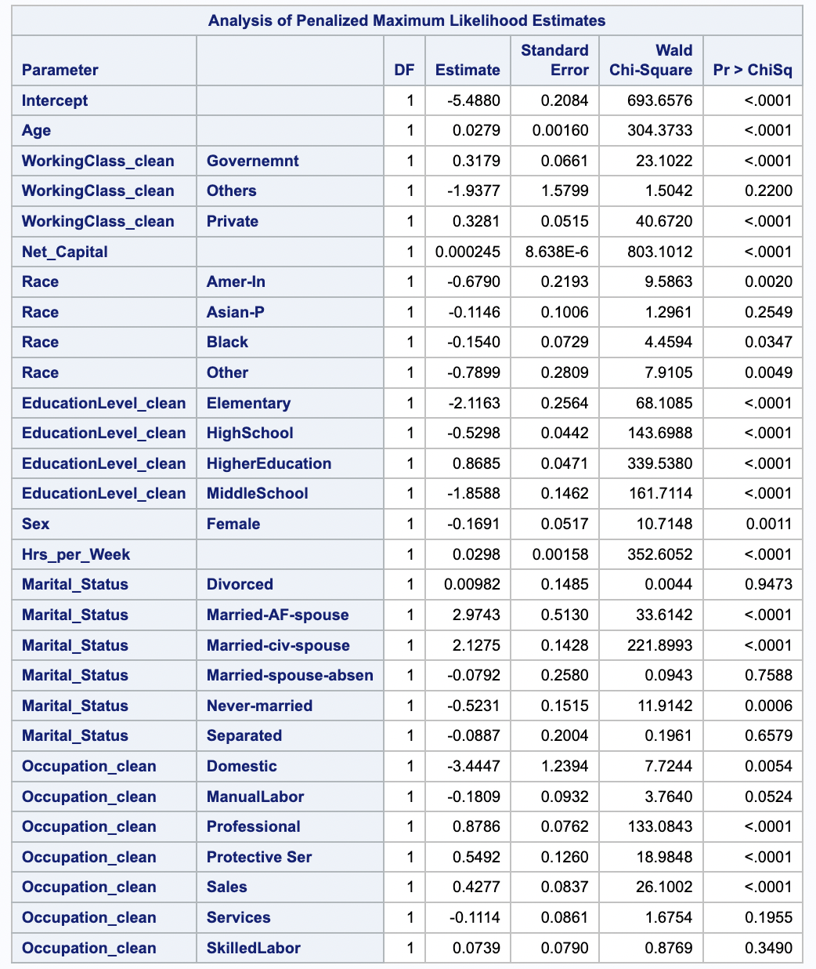
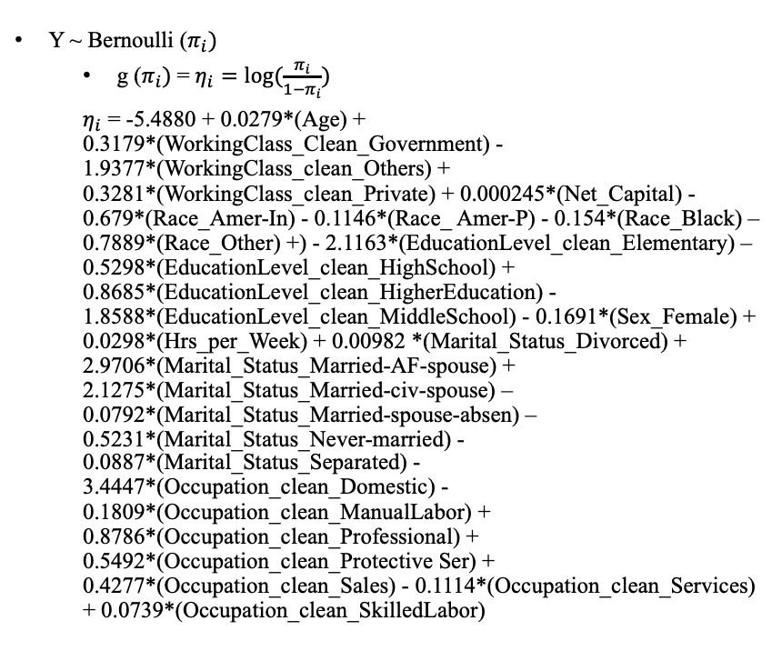
GLM Descriptive Methods (Bernoulli)
Y ~ Bernoulli ($π_{i})$
g ($π_{i})$= $η_{i}=\log{(\frac{π_{i}}{1−π_{i}})}$
$η_{i}$ = -5.4880 + 0.0279*(Age) + 0.3179*(WorkingClass_Clean_Government) - 1.9377*(WorkingClass_clean_Others) + 0.3281*(WorkingClass_clean_Private) + 0.000245*(Net_Capital) - 0.679*(Race_Amer-In) - 0.1146*(Race_ Amer-P) - 0.154*(Race_Black) – 0.7889*(Race_Other) +) - 2.1163*(EducationLevel_clean_Elementary) – 0.5298*(EducationLevel_clean_HighSchool) + 0.8685*(EducationLevel_clean_HigherEducation) - 1.8588*(EducationLevel_clean_MiddleSchool) - 0.1691*(Sex_Female) + 0.0298*(Hrs_per_Week) + 0.00982 *(Marital_Status_Divorced) + 2.9706*(Marital_Status_Married-AF-spouse) + 2.1275*(Marital_Status_Married-civ-spouse) – 0.0792*(Marital_Status_Married-spouse-absen) – 0.5231*(Marital_Status_Never-married) - 0.0887*(Marital_Status_Separated) - 3.4447*(Occupation_clean_Domestic) - 0.1809*(Occupation_clean_ManualLabor) + 0.8786*(Occupation_clean_Professional) + 0.5492*(Occupation_clean_Protective Ser) + 0.4277*(Occupation_clean_Sales) - 0.1114*(Occupation_clean_Services) + 0.0739*(Occupation_clean_SkilledLabor)

Slide 11
Coefficient Interpretations
95% confident interval for the odds ratio corresponding to a female is (e^[(- 0.2705)], e^[(-0.0679)]) = (0.7629, 0.9343). It means that we are 95% confident that the odds of a female’s income is more than $50k is increasing from 6.6% to 23.7%.
95% confident interval for the odds ratio corresponding to a 20-year-old is (e^[3*(0.0247)], e^[3*(0.0310)]) = (1.0769, 1.097). It means that we are 95% confident that the odds of a 20-year-old’s income is more than $50k is increasing from 7.7% to 9.7%.
For a year increase in age, an individual’s odds of having income more than $50K change by a factor of e^(0.279) = 1.0289, hold other factors constant.

Slide 12

Conclusion:
The project's consideration of a wide range of demographic variables as potential predictors, from marital status to race demonstrates a comprehensive approach to understanding income determinants.
Aiming to refine analysis and align with The Glow Company's mission for a more effective and personalized skincare routine.
Strengthened Predictive Models by using both decision tree and random forest, so that I can use
If you have any questions, please don’t hesitate to reach out to me via chi.dang@drake.edu

